Slide 1
Blindsight: Navigation for the Blind
Team CARZ - Charlie Wong, Alec Yeasting, Riley Hunter, Zach Gherman

Slide 2
As-Is Scenario 1
Stevie is trying to go to his next classroom. He knows he needs to walk ahead a few steps, and then turn left around the corner
However, he is not sure when to turn
He took a guess, but turned too early, hit the wall and hurt his head

Slide 3
To-be Scenario 1
The Theia app asks Stevie to give his current location and destination.
The app calculates the route from the current location to the destination
BlindSight tells Stevie to “walk ahead 10 steps, then turn left”

Slide 4
As-Is Scenario 2
Abe is walking on a sidewalk on his way to work at Peid Peiper for the first day using his cane and guide dog.
However, because of the crowded route, it takes Abe longer to meticulously wade through the crowd with the help of the guide dog which ultimately leads him to building next to Peid Peiper.
Abe is 10 minutes late because of this.

Slide 5
To-be Scenario 2
Instead of relying on his own memory, Abe is able to set his route with BlindSight.
BlindSight redirects Abe to a slightly longer but less busy route.
Abe with his trusty guide dog arrives 2 minutes early with the help of BlindSight’s preferred route setting.
“Warning, original route more busy than expected. Redirecting to preferred route.” Continuing on with directions to Peid Peiper.

Slide 6
As-Is Scenario 3
Richard is at the Bellevue Mall by himself trying to get to steakhouse.
On the way Richard with only his cane and google maps gets directed up the escalator.
Richard trips and falls ruining his dress shirt.

Slide 7
To-be Scenario 3
While also helping Richard to a steakhouse, BlindSight also directs Richard up the stair which is preferred communicating “A choice of stairs or escalators ahead detected. Directing up stairs.”
“Proceed to X steakhouse”.
Richard arrives to the steakhouse mess and fall free.

Slide 8
Top Priority AS IS and TO BE (Scenario 3)
What If (What could go wrong)?
Settings were incorrectly configured so that user gets directed to stairs when they prefer some other method of traversing to a new level in a building?
Device loses communication with GPS?
Device is low on power and shuts off during directions?
Device is stolen during directions?
System is closed from SpeechToText input from surrounding white noise (Other people)?
Device is dropped and shuts off?

Slide 9
Top Priority AS IS and TO BE (Cont.)
Who (is using BlindSight)?
Blind User
Caretaker assisting Blind User
Stranger assisting Blind User
What Kinds Of (Navigation)?
Bluetooth
Wi Fi
Magnetometer
Accelerometer
GPS (as a last resort)

Slide 10
Top Priority AS IS and TO BE (Cont.)
When (should the system communicate with the User)?
Approaching a point in navigation where a turn is required.
Approaching a static obstacle such as a desk, trashcan, etc.
Approaching a system that allows user to traverse levels in a building (Stairs, Escalator, Elevator, etc.)
Start of navigation.
Approaching final destination.
Confirming selected route.
Getting route from User.
Updates are available.

Slide 11
Top Priority AS IS and TO BE (Cont.)
How To (Communicate with User)?
TextToSpeech.
Text output to GUI (for non-blind individuals assisting Blind User).
SpeechToText (to get input from Blind User).

Slide 12
Function Point Estimation
We found two methods for function point estimation. The first provided by this class, and the second from another software design class (CptS 583 - Software Quality) which one of our members had prior experience with. Because this member felt more confident in that method we decided to calculate our function point estimates both ways. The method used by this class is called the “Tutorialspoint Method” for our purposes and the other method is the “Geeks for geeks Method”. Both methods ended up with similar average estimates as you will see.

Slide 13
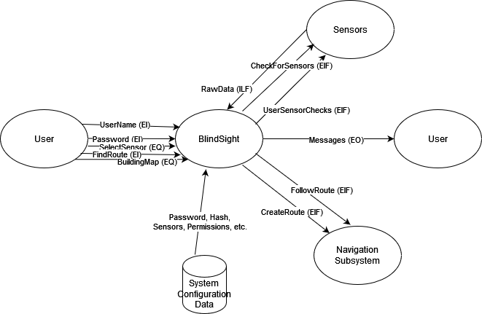

Function Points Estimation - Geeksforgeeks Method
Data Communication 5
Distributed Data Processing 2
Performance 5
Heavily Used Configurations 1
Transaction Role 2
Online Data Entry 0
End-User Efficiency 4
Online Update 1
Complex Processes 3
Reusability 2
Installation Ease 4
12. Operational Ease 4
13. Multiple Sites 0
14. Facilitate Change 3
EI: 3 EO: 1 EQ: 2 ILF: 2 EIF: 4
3 | 3*3 | 4 | 4*3 | 6 | 6*3
4 | 4*1 | 5 | 5*1 | 7 | 7*1
3 | 3*2 | 4 | 4*2 | 6 | 6*2
7 | 7*2 | 10 | 10*2 | 15 | 15*2
5 | 5*4 | 7 | 7*4 | 10 | 10*4
Low | 53 | Avg. | 73 | High | 107
CAF = 0.65 + (0.01 x Sum(Fi))
Sum(Fi) = (2x5) + (3x4) + (2x3) + (3x2) + (2x1) + (2x0) = 36
CAF = 1.01
Low = 1.01x53 = 53.53
Avg. = 1.01x73 = 73.73
High = 1.01x107 = 108.07

Slide 14
Function Points Estimation - TutorialsPoint Method
ILF FPs = 5 * (low complexity: 7) = 35
EIF FPs = 3 * (low complexity: 5) = 15
EI FPs = 3 * (low complexity: 3) = 9
EO FPs = 2 * (low complexity: 4) = 8
EQ FPs = 2 * (low complexity: 3) = 6
Because we designed for a minimum viable prototype, we minimized complexity which resulted in lower function point values for each step.
DFP = ADD + CFP = 35 + 15 + 9 + 8 + 6 = 73

Slide 15
Creeping Rate
For creep rate we calculated with 4 engineers over the course of 3 months completing 3 function points a week we could complete a total of 144 function points.
Starting from a base function points number of 73 that the maximum achievable creep rate is 32%
(3 months of 32% creep rate from 73 function points = 143.08 total function points)

Slide 16
Comparison
 | Cane | Guide Dog | Theia
Reliability | Average +/- | Average +/- | High +
Difficulty of Use | Low + | Low + | Low +
Cost | Average +/- | High - | Low +
Comprehensibility of Information | High + | Average +/- | High +
Softness | Low - | High + | Low -
Emotional Support | Low - | High + | Average +/- (Low without extension of capability)

Slide 17
Why BlindSight is the best option for Blind Navigation
Blindsight will be cheaper than all the other options available to a blind person. It will be easy to communicate with for a blind person and provide them with more autonomy than the other options. A cane gives a narrower field of information for a blind person while being bulky and prone to user error. A guide dog cannot communicate to the same depth of information as our system will and are far more difficult to train, resulting in a higher cost to providing it for more blind people.

Slide 18
Extra Information
In the following slides you will find additional information about how the team plans on tackling some important aspects of the project.
The slides are unmodified from our initial presentation and is not necessary for the deliverable, you may stop here.

Slide 19
Introduction
Due to the size of the project, there were some questions we had to consider at the start of designing our project:
How will the system relay information to the user?
How will the system track the movements of the user?
How will the system process collision avoidance?
How do we envision the system to look?
How can we make this project achievable?

Slide 20
Audio In/Out
Soundpool
A method that allows the developers to play a sound byte on an action/event.
Allows for the creation of a collection of sounds that the system can pull from.
AudioManager
Another method that allows the developers to play a sound to the user.
Generally used for playing longer sound bytes (such as full length songs in .mp3 or .wav format).
TextToSpeech
A method which allows the developers to have customized audio messages based on textual outputs from the system.
SpeechRecognizer
A class which allows the developers to invoke an intent to process speech into text for further processing. Easy to use for yes/no questions and basic category based user search.

Slide 21
Positioning System
Development based research into different basis positioning systems:
Accelerometer based
WiFi based
Bluetooth based
Magnetometer based

Slide 22
Collision Detection
Our approach:
Use machine processing on standard camera data to estimate distances. Computer vision is beginning to be a mature field of computer science so we have no need to develop a system ourselves. We will try to use outside methods and libraries for this. OpenCV is our currently selected best candidate for doing this once we have a reliable stream of camera data.

Slide 23
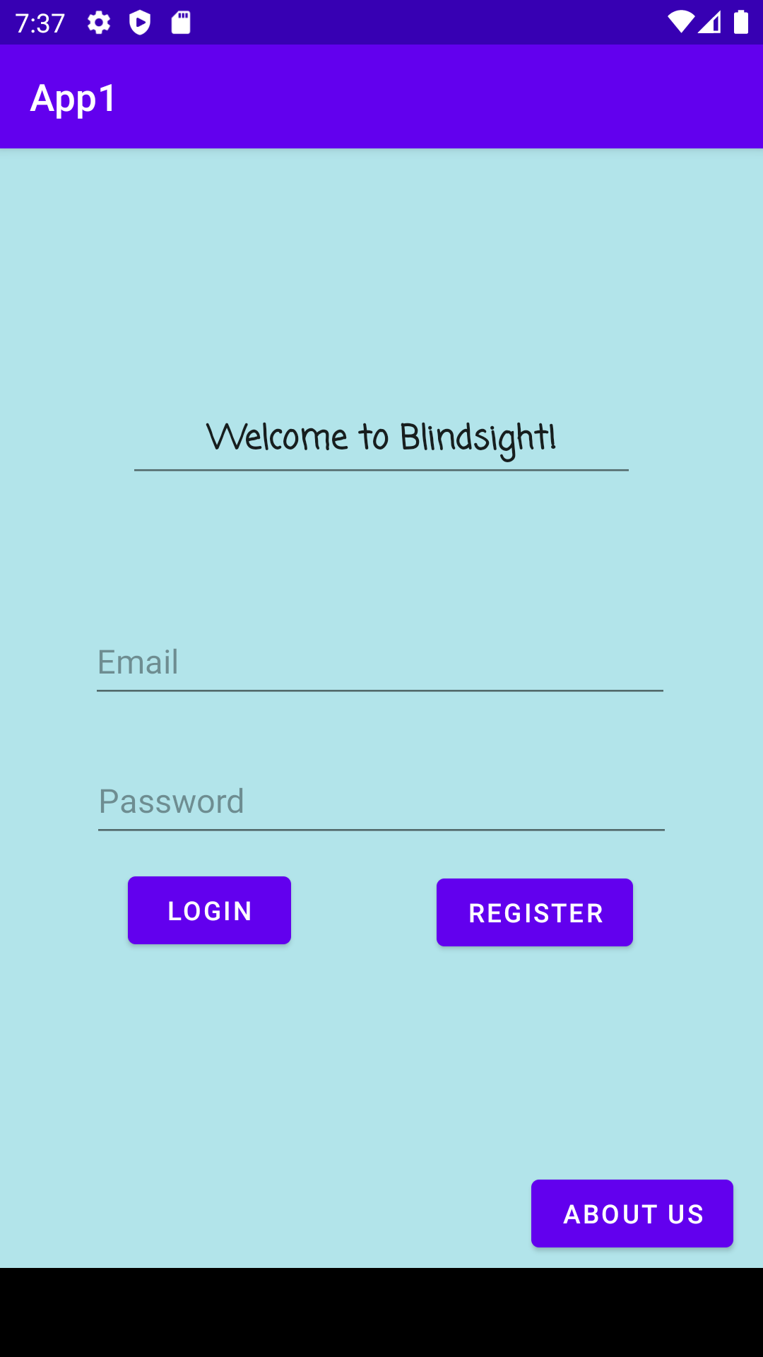
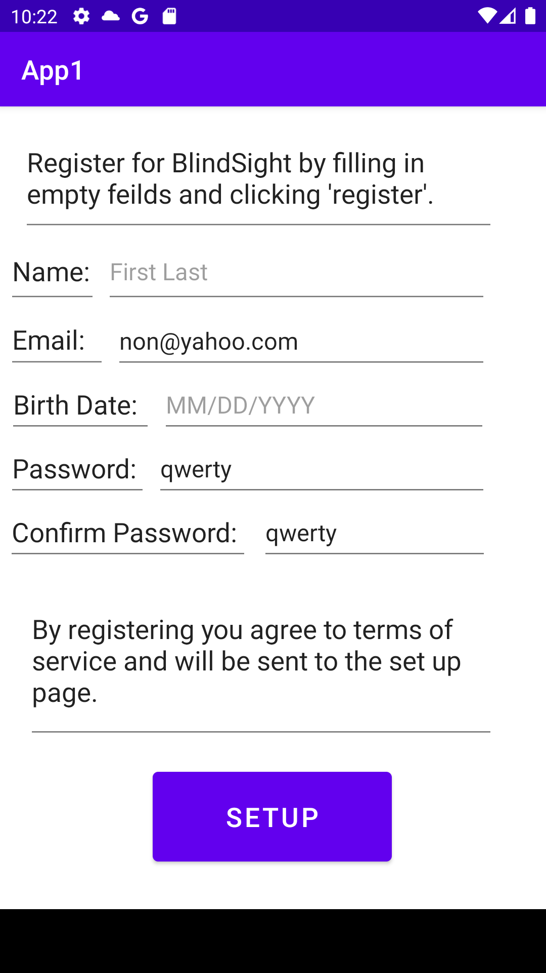
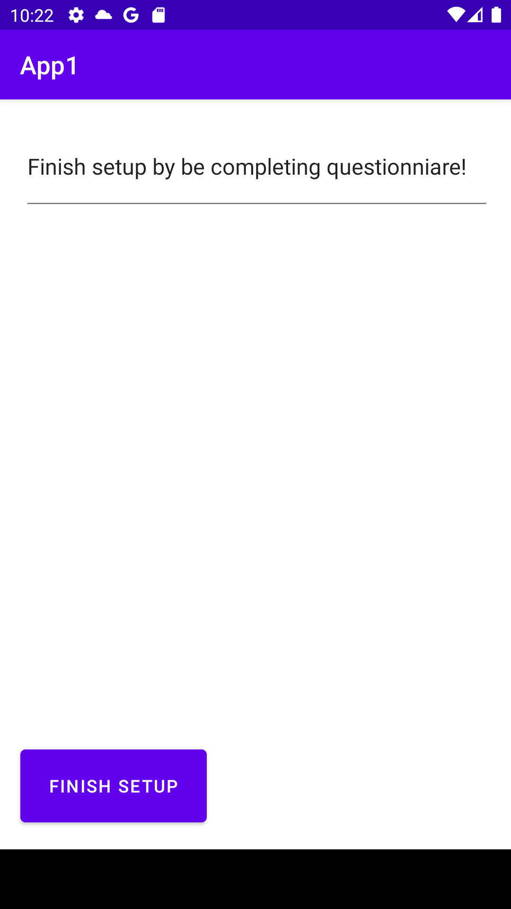
User Interface (Current Mockup)
Figure 3. Setup page (for now questionnaire is left blank).
Figure 1. Login Page - Local email/password (serverless).
Figure 2. Registration page (general account information).

Slide 24
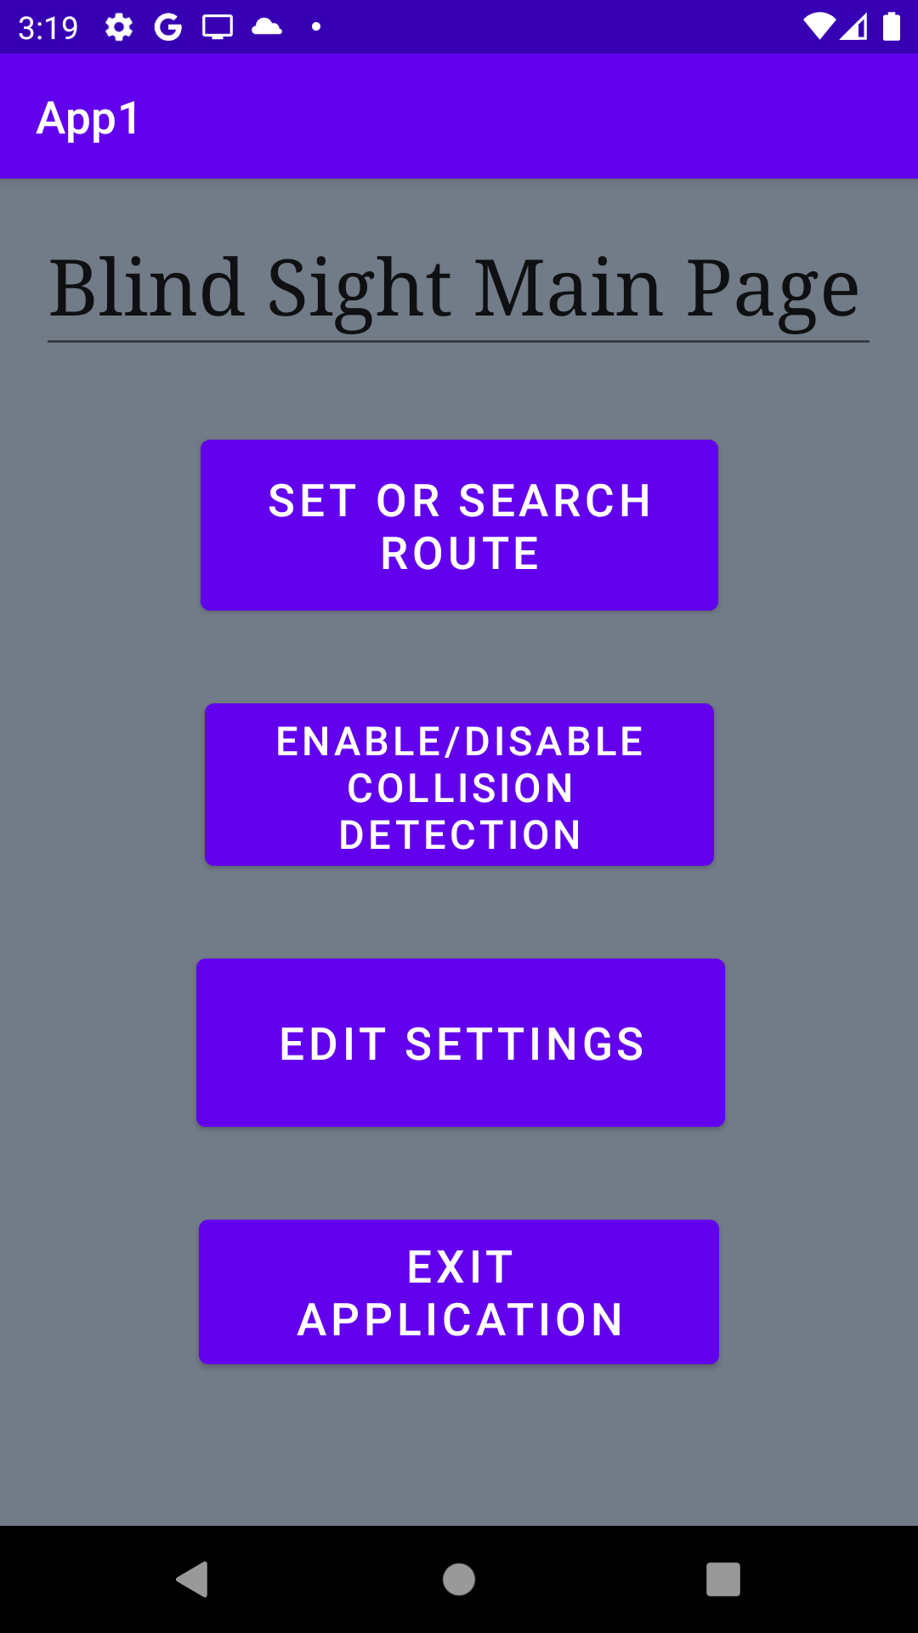
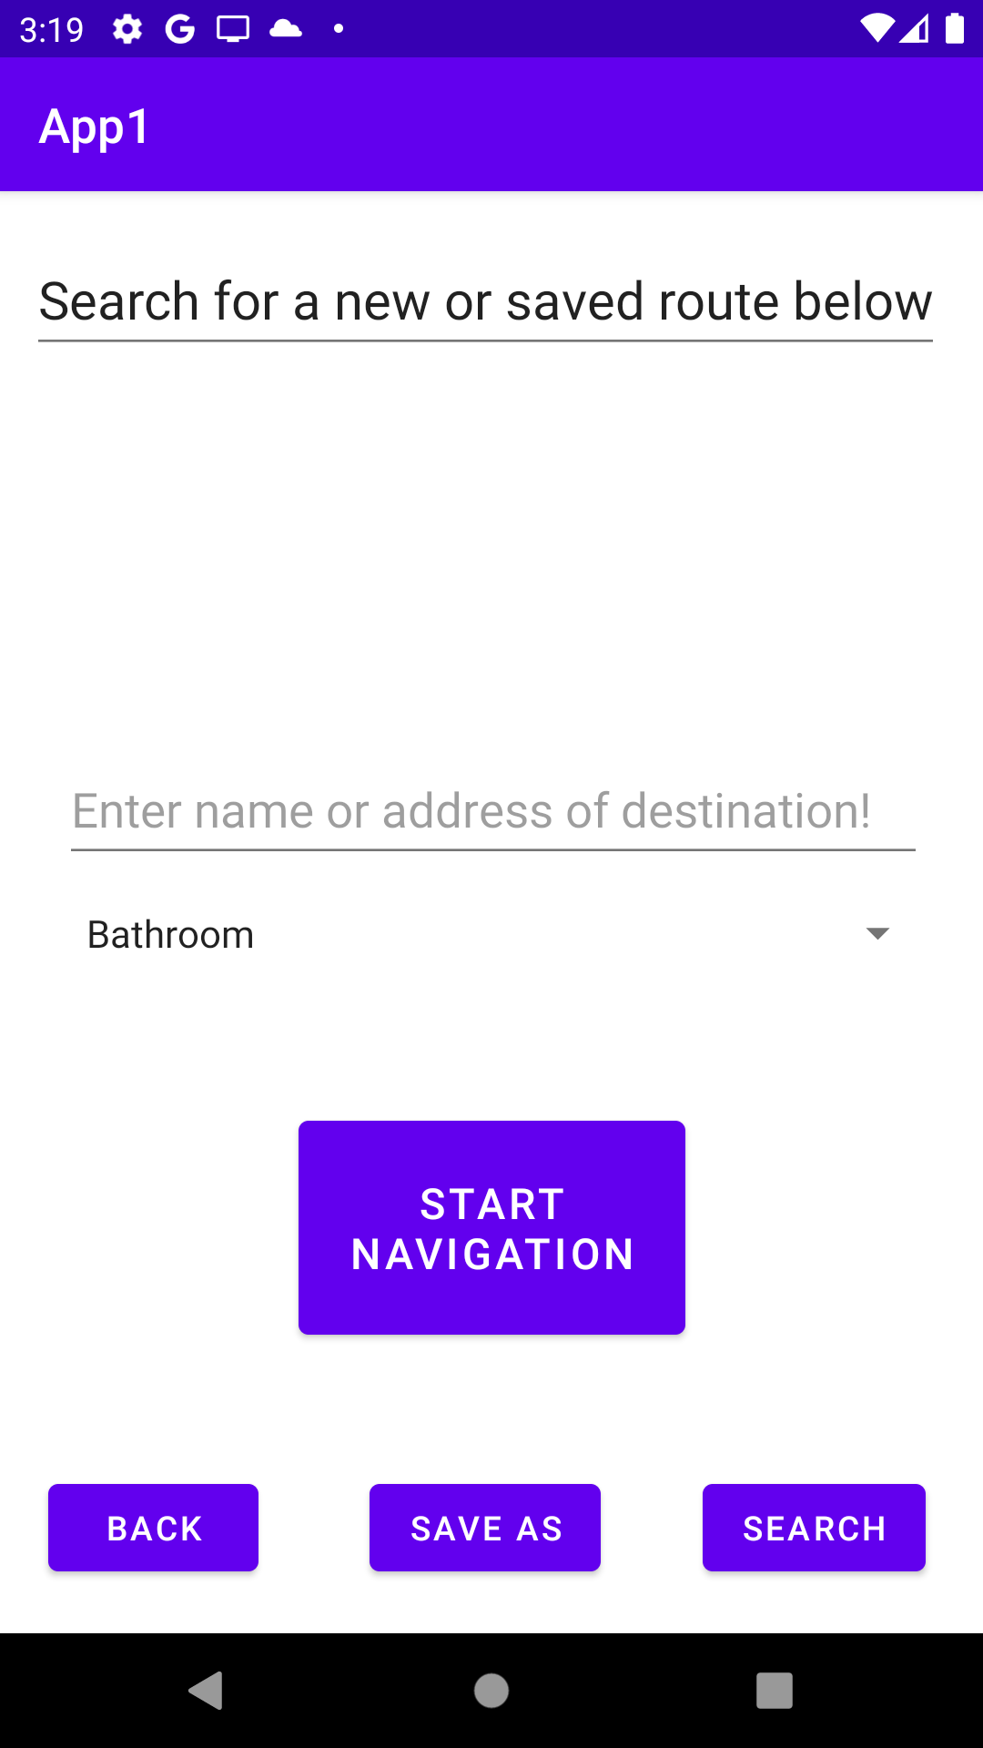
User Interface (Current Mockup)
Figure 4. (To the left) Main activity page where user selects the option needed.
Figure 5. (To the right) Set/search route for navigation page. Ability to search/save a particular destination/route. Contains start navigation button.

Slide 25
User Manual
Signing into your local (serverless) account
Registering and setting up your account
Navigating the main application
Account Settings

Slide 26
Project Definition
Goal : To help blind individuals navigate indoors and across multiple floors of a building.
Scope: Android Mobile Devices 5.0+ (Lollipop or later).
Objective(s): - To help blind individuals navigate indoors. - To help blind individuals avoid obstacles.
Limitations: Knowledge of Android Studio, DenseNet, Bluetooth positioning, Wifi positioning.

Slide 27
Project Definition (Continued)
Success Criteria:
Build a working prototype that utilizes at least one positioning system to achieve a reasonably accurate indoor navigation system in an arbitrary predefined environment.
Build a working prototype that utilizes a camera to accurately determine the position of at least one obstacle in the blind individual’s path.

Slide 28
Creeping Rate
What creeping rate can we handle?
Low. The scope of the project is big enough that we need a good plan for keeping creep at bay. All of us will already each need to individually learn a lot for the project to be realistically possible.

Slide 29
How we plan to combat Creep
Building small prototypes of key components.
Setting reasonable time frames for development and documentation creation/evolution.
Adherence to the documentations set forth by the team.
Treat our development as research, we need to be flexible enough to abandon a less feasible idea for a more feasible one to accomplish the project description.
TESTING TESTING TESTING!

